Slide 1

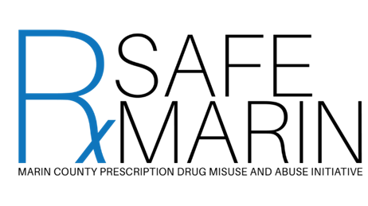
Tackling the Opioid Epidemic Locally: One County’s Approach
Matt Willis, MD MPH
Public Health Officer, Marin County
Clinical Lead, California Opioid Safety Network
RxSafe Marin Co-founder
Notes:
Thank you for the invitation for this critical topic in California.
It has been an honor to work closely with Dr. Smith to tackle this pressing crisis.

Slide 2
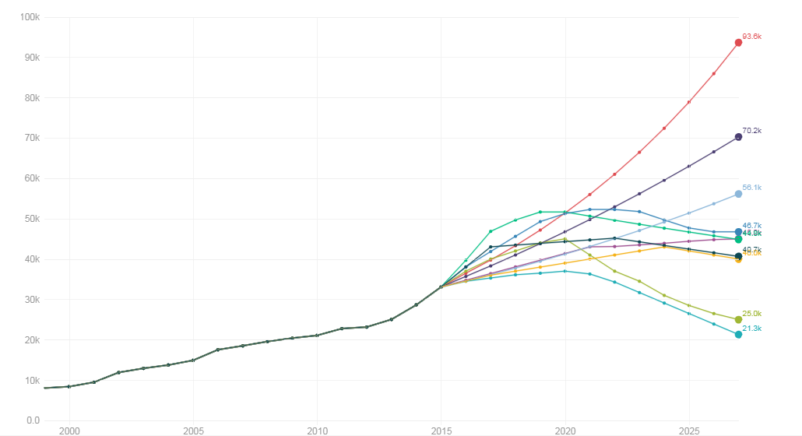
Which Future Will We Choose?
Opioid overdose deaths: 10 projected scenarios
Current trajectory
2017
https://www.statnews.com/2017/06/27/opioid-deaths-forecast/
Notes:
So what future will we choose? We have a choice. This shows a model that was developed that played out 10 different scenarios for the future of the epidemic. Each line represents a different relative success of different strategies. Bad news and good news. The bad news is that if we don’t do anything we can expect a continuos acceleration. The top line. The most optimistic model, the bottom blue line, assumes that we’ve optimized multiple strategies. Safe prescribing, access to MAT, reduced stigma, drug take back, access to naloxone.

Slide 3

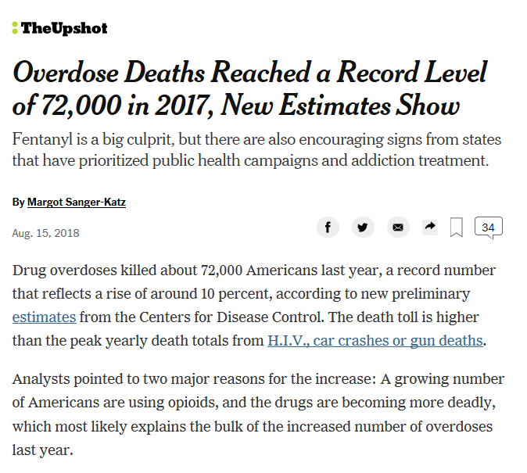

Slide 4
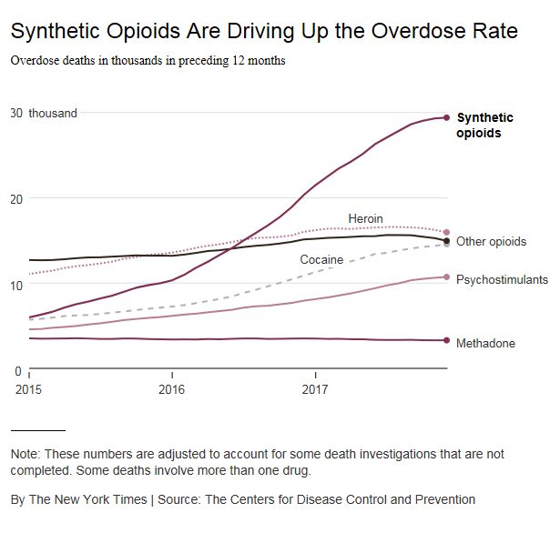

Slide 5
Calls for Collective Approach
“We need an all-hands-on-deck-approach that says… all of us are working together in order to address this problem.”
  President Barack Obama, National Rx Drug Abuse and Heroin Summit, 2016
  “The epidemic will worsen in the absence of coordinated and collaborative community-wide approaches.”
  Institute for Healthcare Improvement, 2016: Addressing the Opioid Crisis in the United States

Slide 6
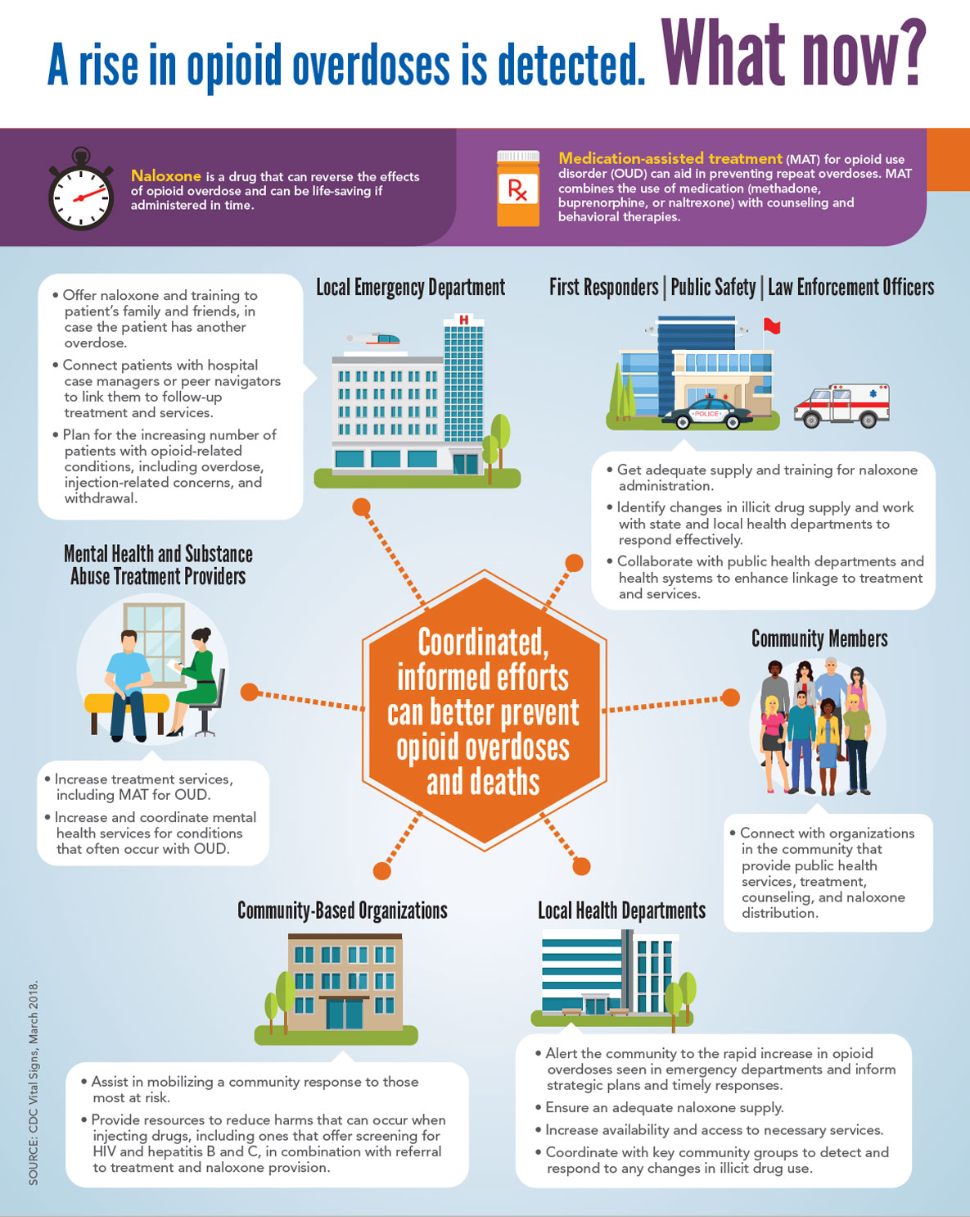
March, 2018
CDC Recommends inter-sectoral response to increasing overdoses

Slide 7
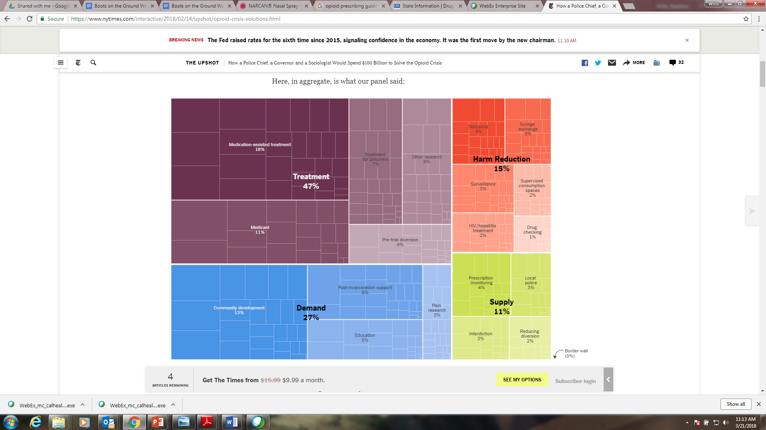
How a Police Chief, a Governor and a Sociologist Would Spend
$100 Billion to Solve the Opioid Crisis
New York Times, February 14, 2018 https://www.nytimes.com/interactive/2018/02/14/upshot/opioid-crisis-solutions.html

Slide 8
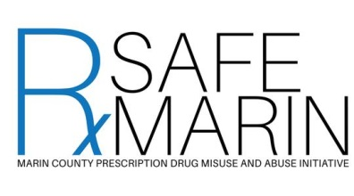
RxSafe Marin Video
Notes:
Link: https://www.dropbox.com/s/v0gvkj0ksfzfiuv/MRN004_RXSAFE_11-H264_1080p.mp4?dl=0

Slide 9
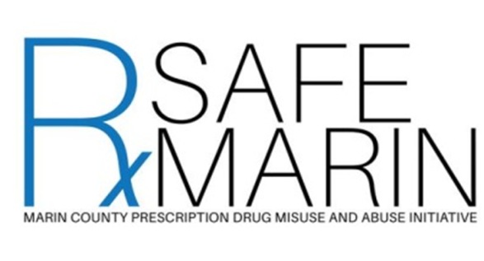
Key Accomplishments
Prescribers and Pharmacists
  Safe Prescribing Standards
  Naloxone distribution
    Pharmacy, Healthcare, Jail, Police, Schools, Library
Law Enforcement
  Safe drug disposal ordinance
  DA letters to prescribers of arrested patients
Treatment and Recovery
  “Hub and Spoke” MAT program
  Buprenorphine trainings
  EMS overdose follow up
Community based prevention
  Media campaign
  Infographics for clinics and community
  Social host ordinance
Data
  RxSafe Marin Report Card

Slide 10
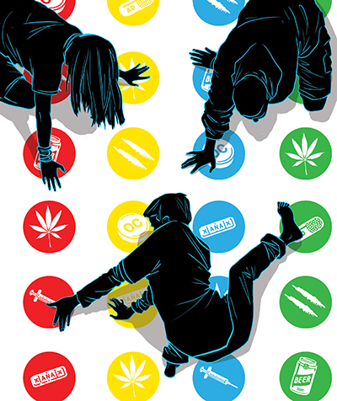
RxSafe Marin Formation:
An Emerging Epidemic
Data:
In Marin County between 2006 and 2013 there was a doubling in:
  Opioid prescriptions
  Opioid related emergency room visits
  Accidental drug overdose deaths
One in five Marin high school juniors reported misusing pain killers

Slide 11
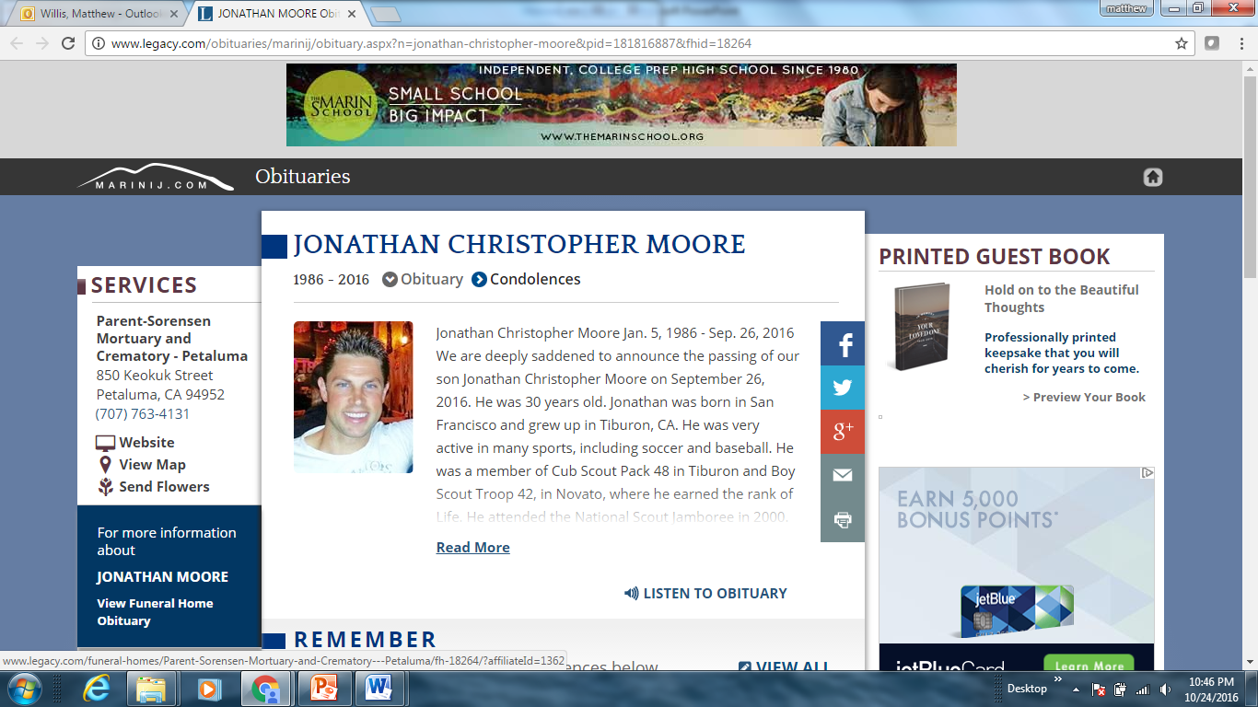
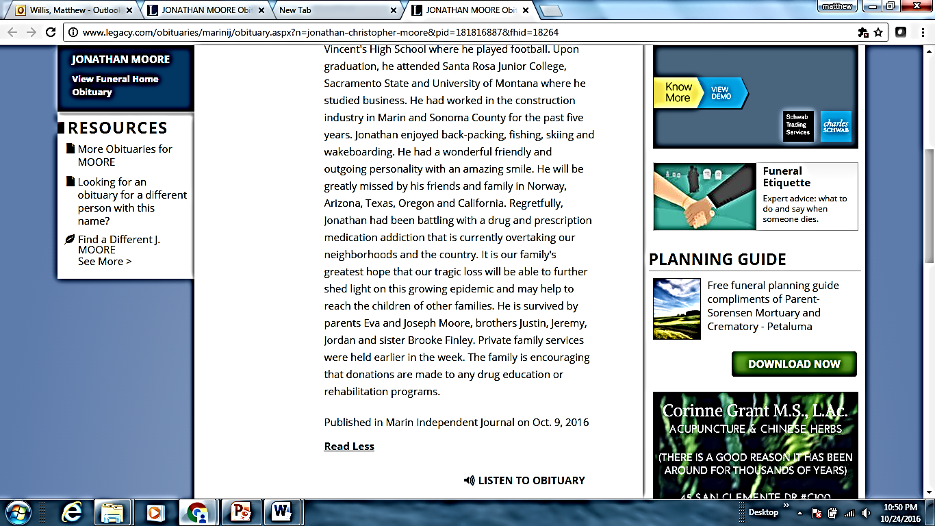
Marin Families

Slide 12
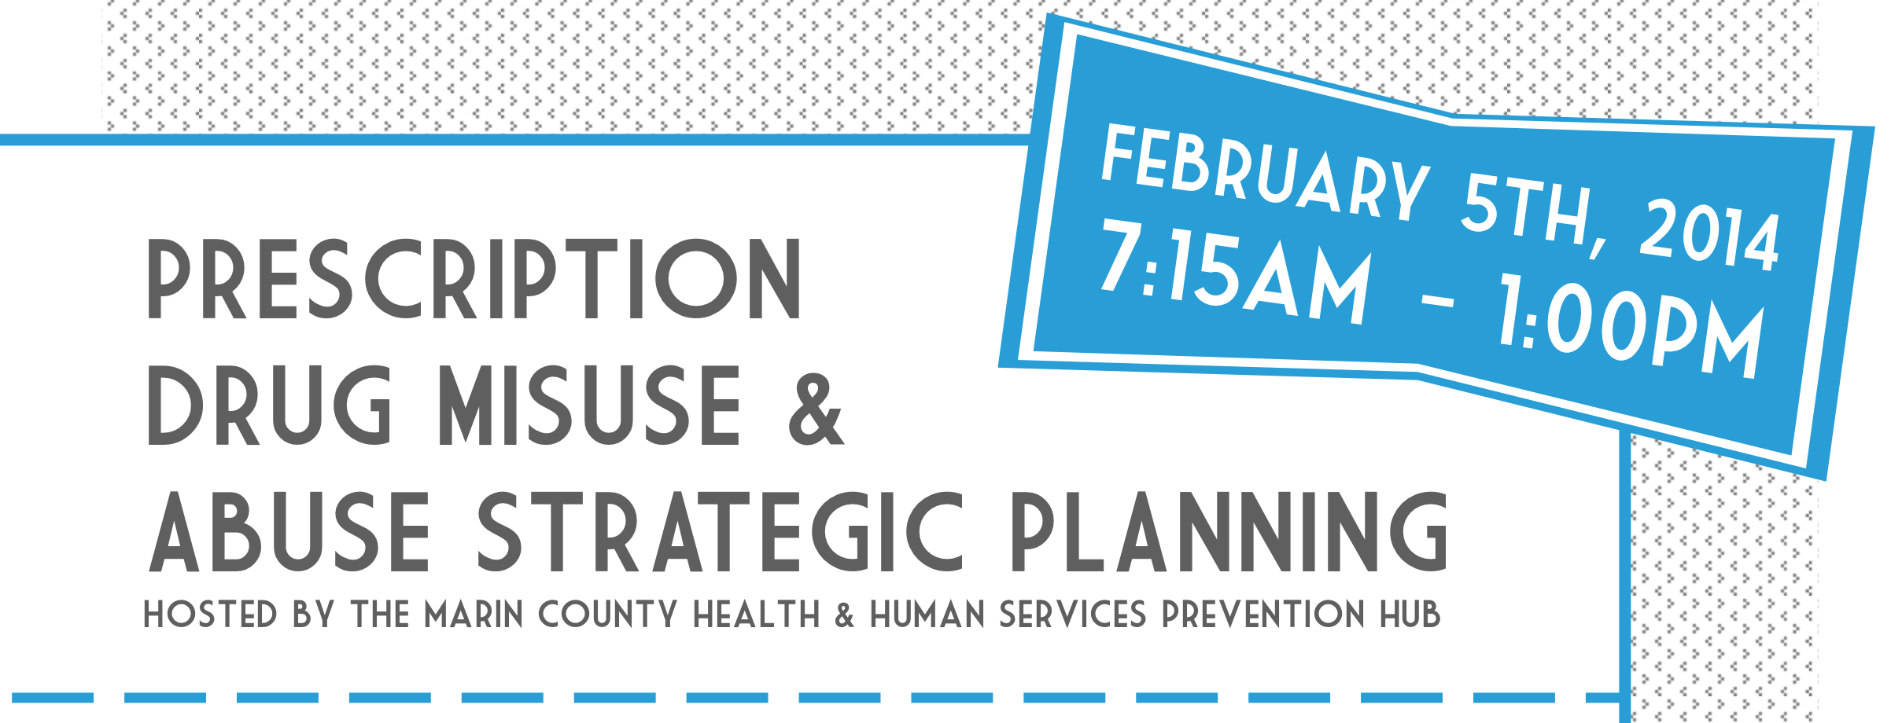

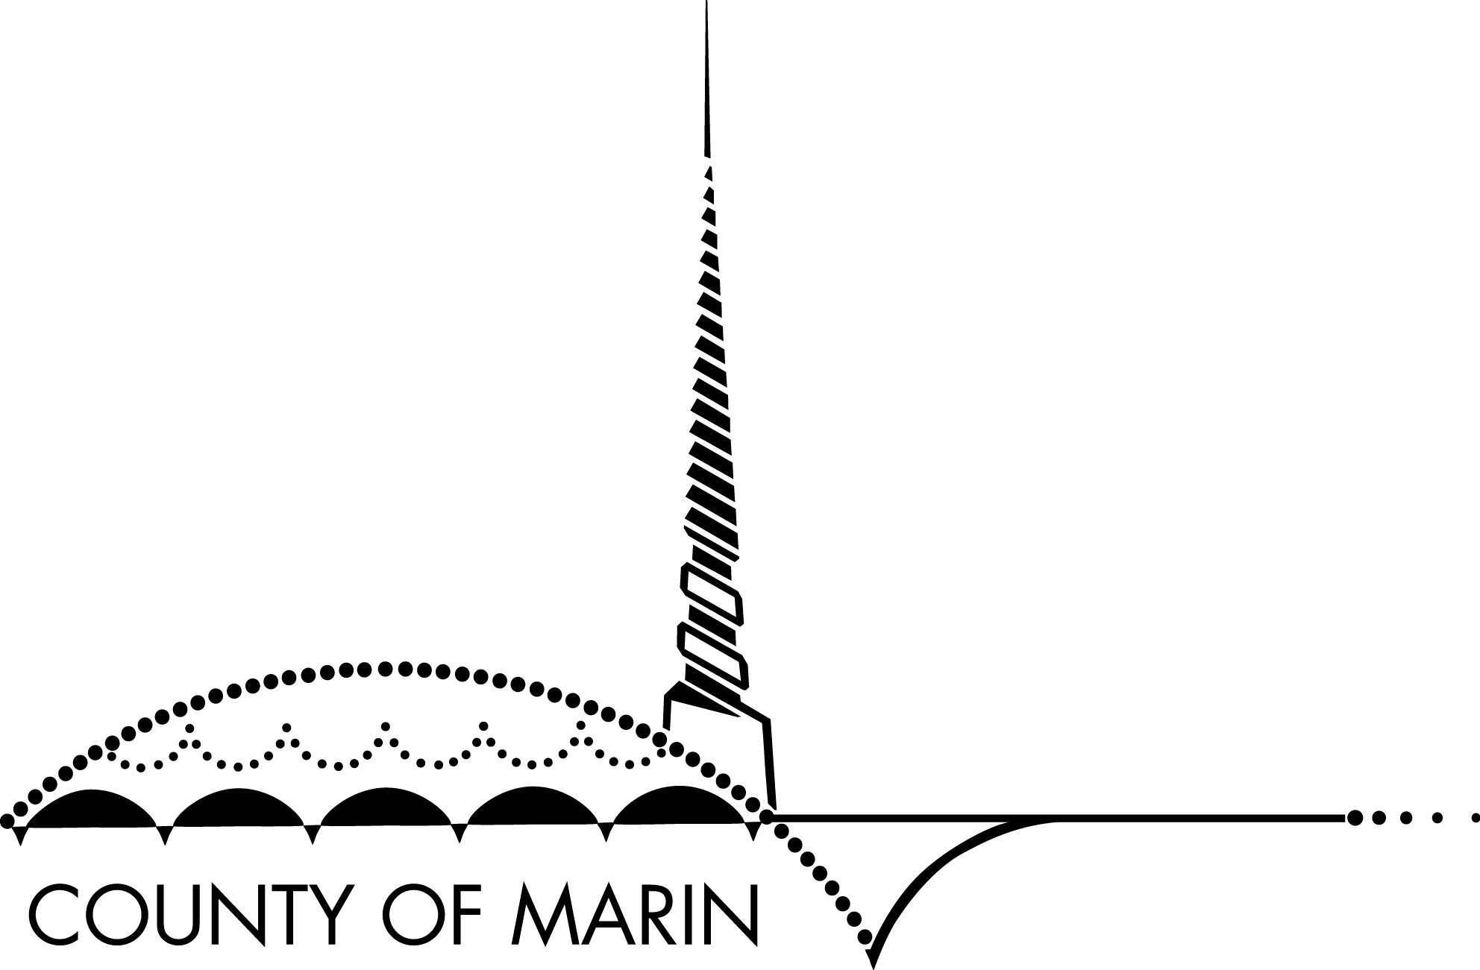
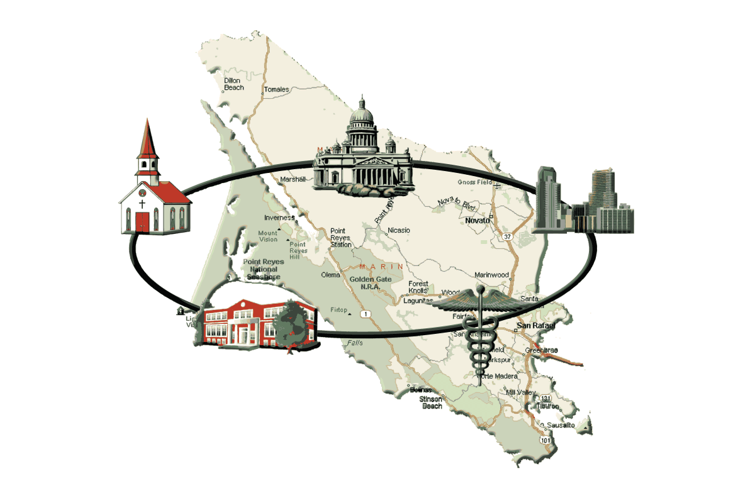

WELCOME
What can we do as a community to prevent prescription drug abuse and save lives?

Slide 13

Community Based Prevention
Action Team
Data Collection and Monitoring
Action Team
Steering Committee:
Representing MCOE, HHS, Healthy Marin Partnership, Clinicians, Community Members
Law Enforcement Action Team
Intervention, Treatment and Recovery
Action Team
Prescribers and Pharmacists
Action Team
Backbone Support: HHS

Slide 14
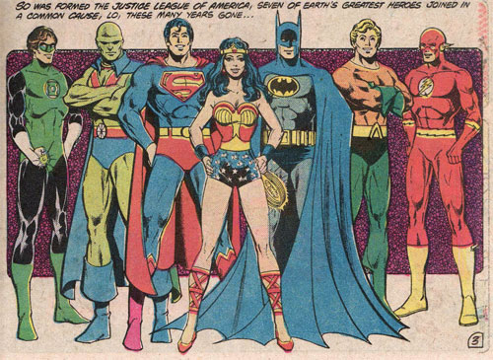
Notes:
Coalitions are much like the Justice League…. Everyone person and every sector has their superpower.

Slide 15
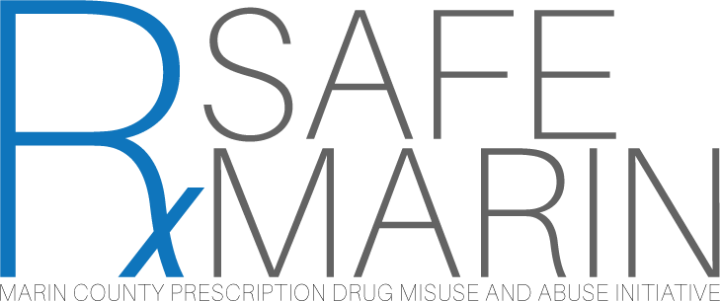
Preventing Overdoses:
Naloxone distribution in Marin County
Naloxone
prescribers
first responders
other community settings
schools
jails
pharmacies

Slide 16
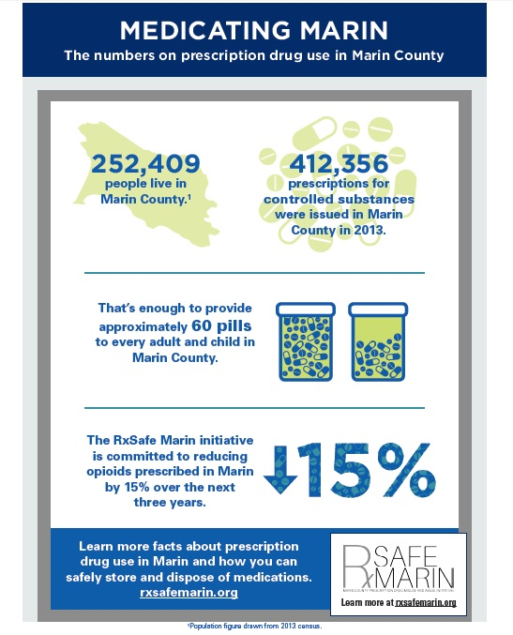

Slide 17
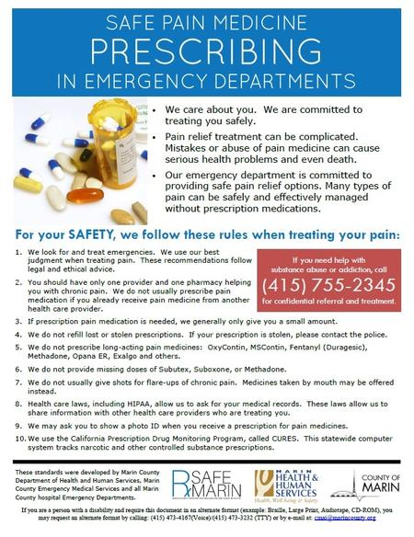
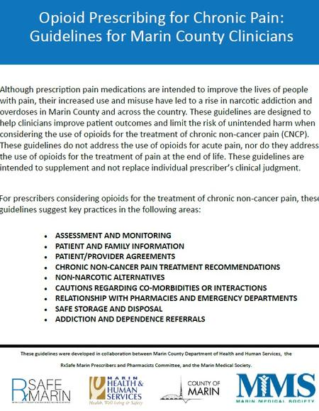

Slide 18
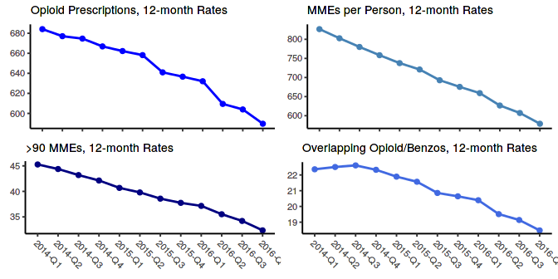
Results:
Marin County Opioid Prescribing, 2014-2016
35% decrease
22% decrease

Slide 19
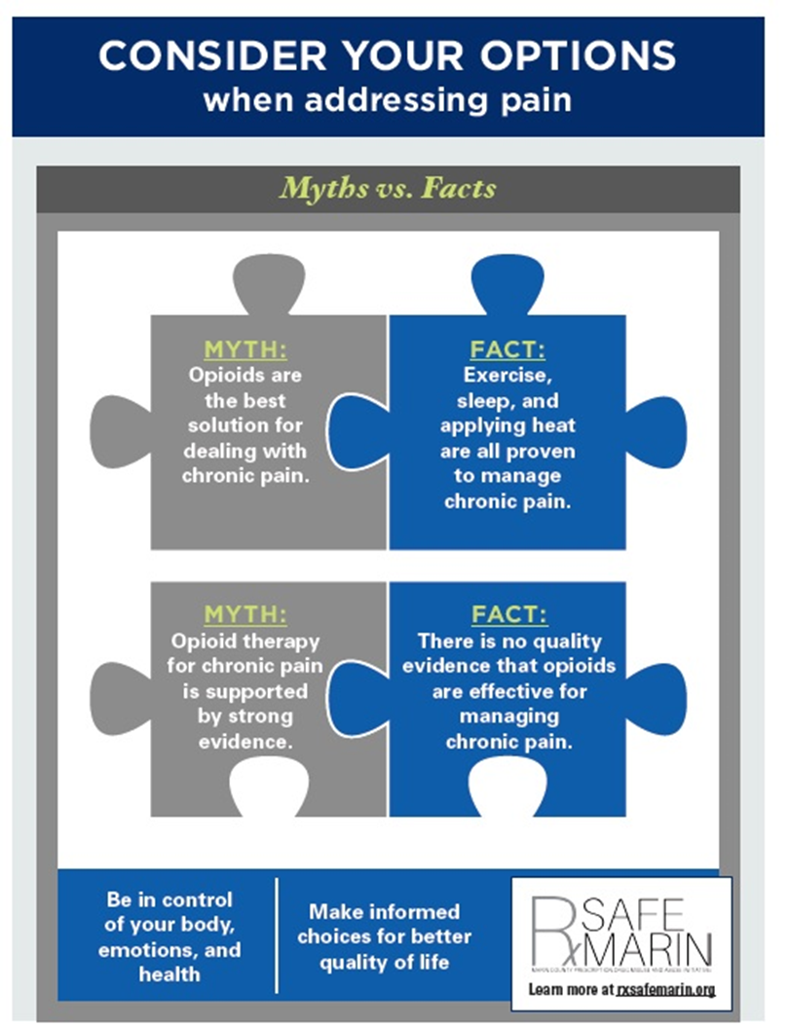
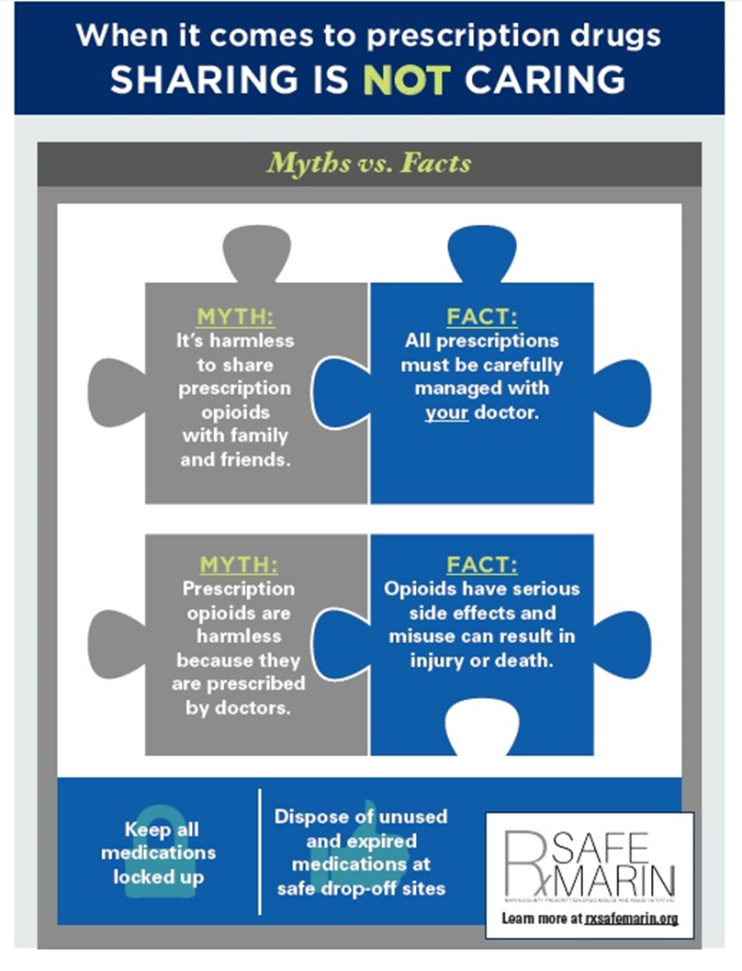
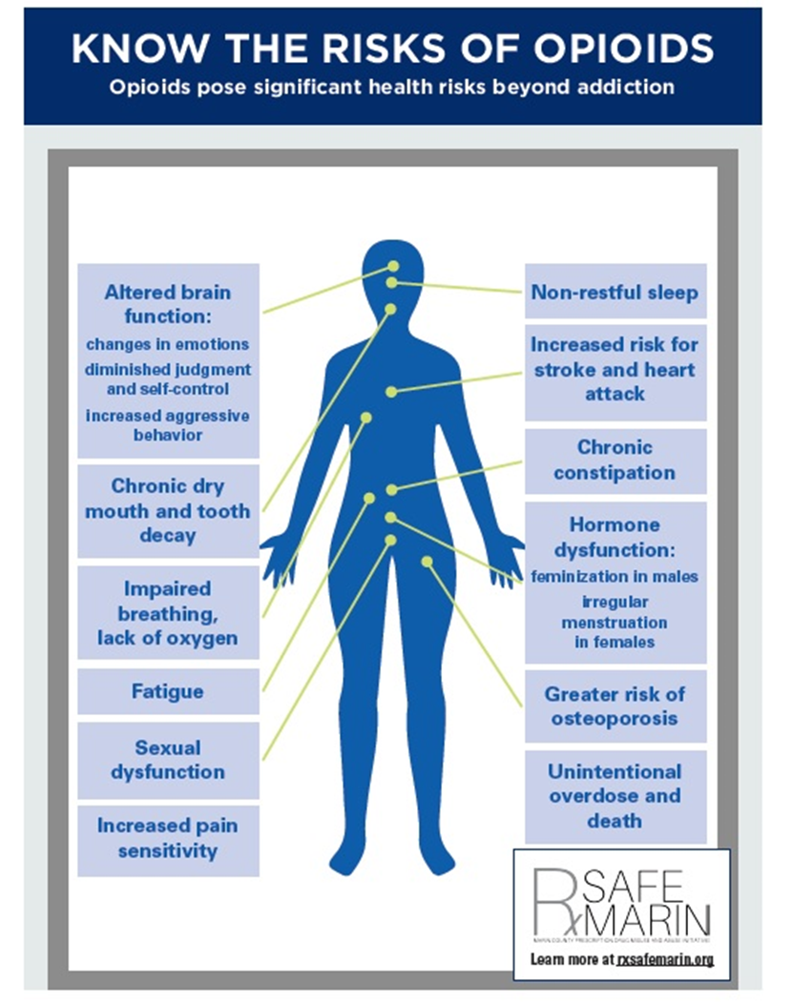
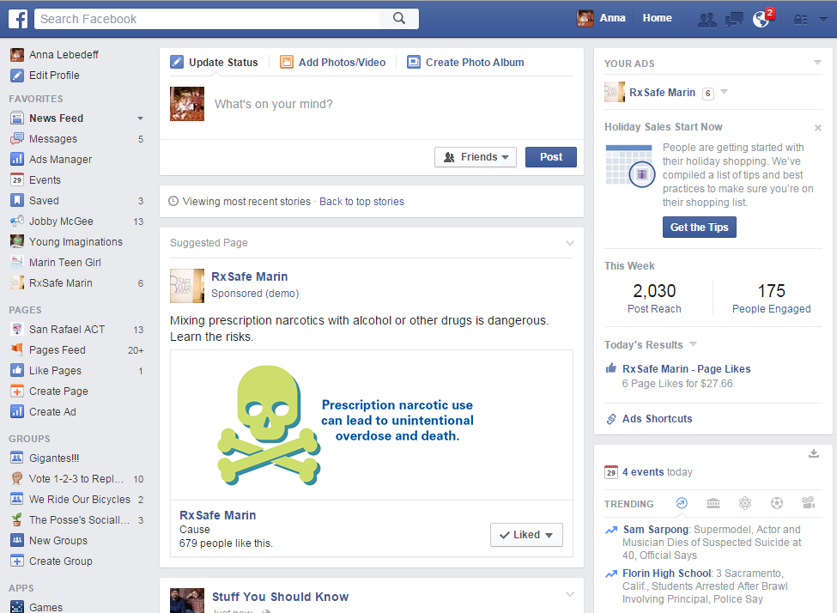
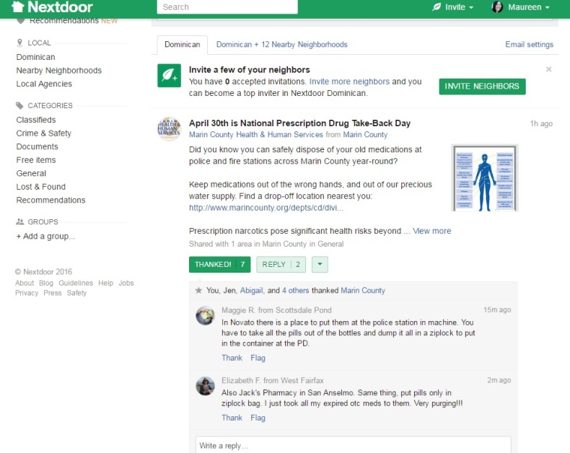
Notes:
Policy:
RxSafe Marin has helped to advocate with the Marin County Board of Supervisors and County Counsel to adopt an amendment to the existing County Social Host Ordinance to include controlled substances and restorative justice elements for juveniles. The Social Host Ordinance holds youth/or adults accountable for hosting underage drinking parties. In February, these amendments passed unanimously and will take effect 30 days after 2/9/16 when the ordinance revisions were approved. This received press from the Marin Independent Journal, the Patch, the Point Reyes Light, and KQED Radio.
Promotion and Visibility: Using infographics in English and Spanish – printed for Seniors – online, poster size in medical offices

Slide 20
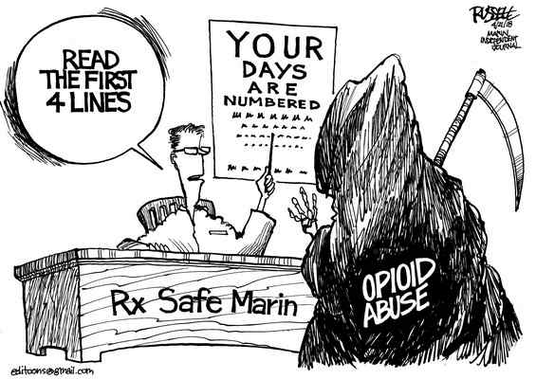

Slide 21
With increasing availability of fentanyl and illicit opioids, controlling supply is even more challenging
In order to save lives we need to address demand

Slide 22
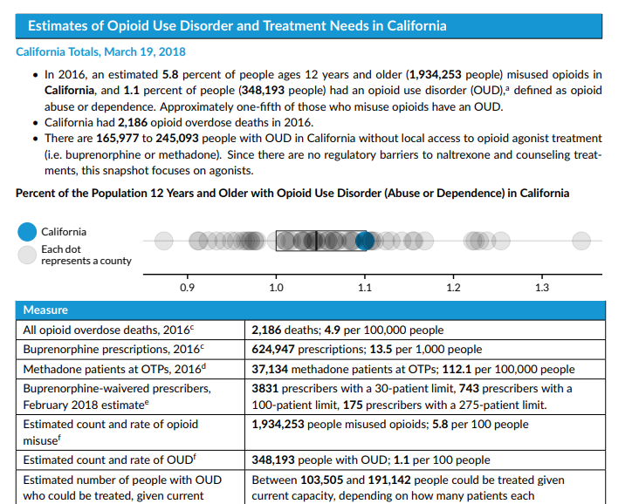
Estimating Demand:
Urban Institute County Fact Sheets
Snapshots by county available at www.urban.org
.
Notes:
Urban institute report: estimates based on epidemiologic data preva;nece of OUD in each county, and compares to number pf prescribers prescribing MAT, and describes the gap. Every county has a significant treatment gap, and across the state they estimate 165-245 thousand with addiction who do not have treatment.
This is an effective way for us to approach this conversation about strategies– how do we close the treatment gap in our communities?

Slide 23
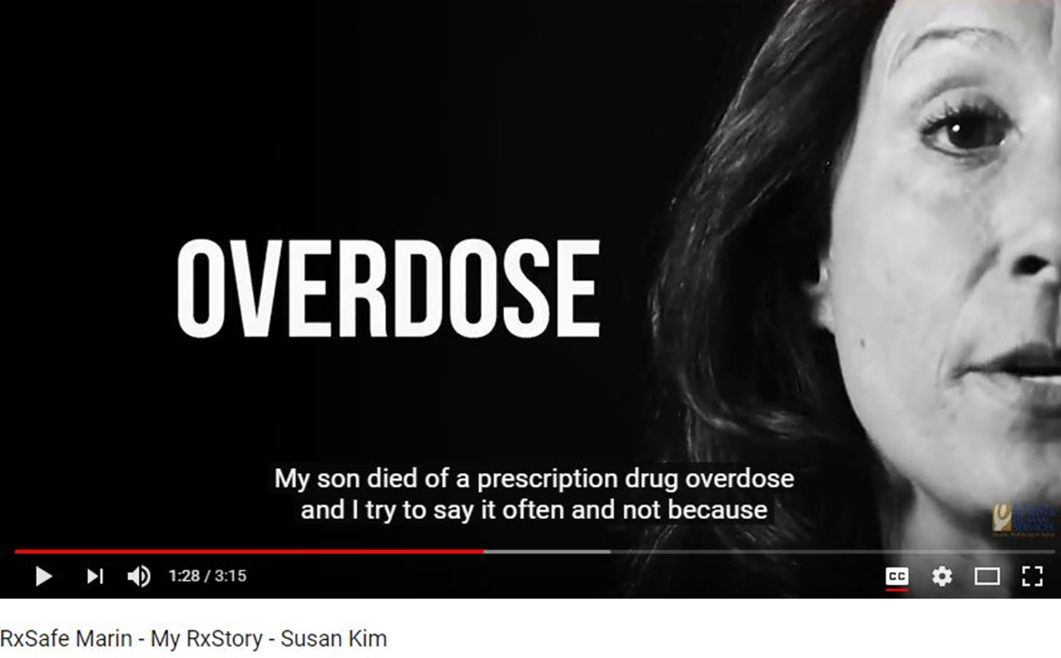
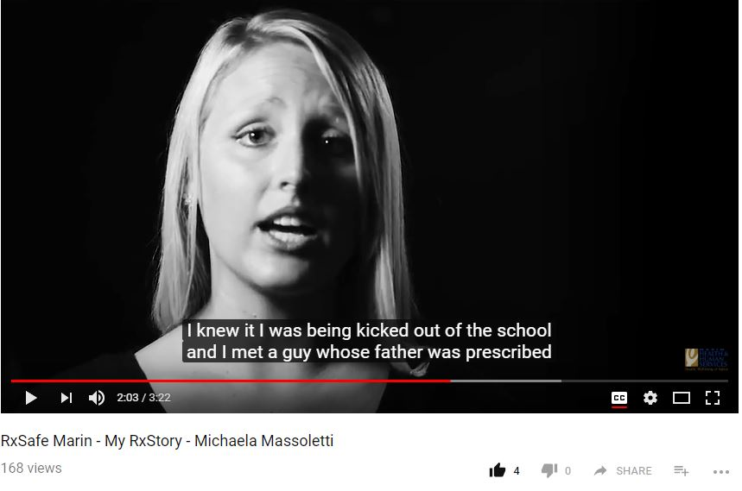
Reducing stigma:
Local stories, Local faces

Slide 24

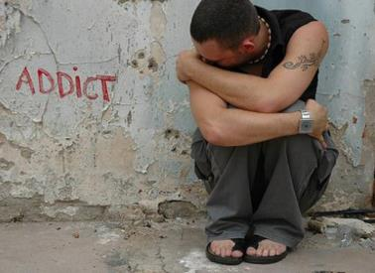
Diabetes vs. Addiction:
Cause: Genes, environment, and behavior
Prevention: Early intervention, behavior change
Treatment: Long-term chemical replacement
5/9/2018
24
Notes:
Let’s talk about why we aren’t where we need to be.
We use this comparison a lot – but it is worth calling out, that we have very different judgments about diabetes vs addiction.
Both caused by a mix of factors: genetic predisposition, environment, and our behavior.
Both can be prevented with early intervention and behavior change.
One of them gets you support, 10k races, ribbons, sympathy.
The other brings you contempt and rejection.
Things we would never say based on race and sex we feel comfortable saying to people whose brain chemicals are altered by a substance use disorder.
But in the end, in both diabetes and addiction, you have a chemical problem:
But we are fine giving insulin for life when you can’t make it (or can’t make enough).
But if You don’t make enough dopamine –we really struggle with the idea that you need medications to balance out your brain chemistry, and that you may need them long-term, even life-long

Slide 25
What could you lose? Diabetes vs. Addiction
Treatment
Custody
Freedom (probation)
Housing
Family
Work
Identity
Situation: You Make a Mistake
No
Yes
No
Yes
No
Yes
No
Yes
No
Yes
No
Yes
No
Yes
5/9/2018
25
Notes:
In the US we don’t tend to punish diabetics – we accept that it is difficult to eat right, exercise and lose weight.
Mastering addiction is even harder – yet we expect perfection.
Binge on Krispy Kremes and your provider says, okay, let’s keep working on this. Have one slip up with a drug and what do you lose?
By identity -- think about what it means to be one year sober, two years sober in 12-step culture. If you make a slip you lose that entire identity of being in recovery – all those years are lost – and you go back to day one.

Slide 26
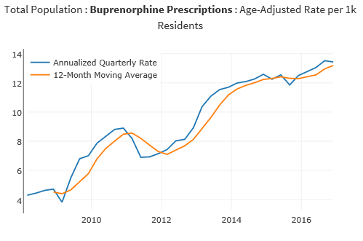
Dashboard:
Buprenorphine Prescribing Rates
California Opioid Overdose Surveillance Dashboard: https://cdph.ca.gov/opioiddashboard
Notes:
The dashboard also has Bup rx. We don’t have easy ways to track access to ALL addiction treatment, but buprenorphine prescribing is easily available in our on-line state dashboard, and we are going in the right direction.

Slide 27


Treatment needs to be easier to access than street drugs
Brain in a tempest:
Addiction means day-to-day survival
MAT stabilizes brain chemistry: Ability to focus on recovery
Treatment success at 12 months:
Treatment with medications*
Methadone: 74-80%
Buprenorphine (Suboxone): 60-90%
Naltrexone (Vivitrol**): 10-31%**
Treatment without medications: 6%
*Based on meta-analyses of research studies; rates of success lower in real-world settings
**Most Vivitrol studies done for 3-6 months; 12-month registry study only had % discontinued due to meeting goals
Source: California Health Care Foundation, Why Health Plans Should go to the MAT in the Fight Against Opioid Addiction
5/9/2018
27
Notes:
Reference for table: Health Management Associates, Why Health Plans Should go to the MAT in the Fight Against Opioid Addiction:. Table on page 6, with multiple references. http://www.chcf.org/~/media/MEDIA%20LIBRARY%20Files/PDF/PDF%20W/PDF%20Why%20Health%20Plans%20Should%20Go%20to%20the%20MAT.pdf
The Vivitrol estimate adjusted up to 31%, based on this recently published meta-analysis:
Jarvis, et. Al., Extended-release injectable naltrexone for opioid use disorder: A systematic review, Addiction. 2018 Feb 3. doi: 10.1111/add.14180. Quotes below are from this paper (emphasis added):
“Longer adherence rates (13 and 19 months) were reported in a study from Russia (56), which showed that individuals who completed 6 months of XR-NTX or placebo treatment in a previous study (27) adhered continuously the following year at rates of 58.2% and 68.1%, respectively (31.0% and 25.8% of the original samples, respectively).”
Jarvis reports a study of health care professionals showed 55% retention at 12 months, but n was small (49 total in study) and not representative of a general population (included only professionals).
“Seven retrospective studies reported adherence outcomes (22, 58-63) (Table 4). Observation periods were generally around 6 months long. The decline in adherence rates over time varied, but were less than 50% by the third injection (pooled estimate [95% CI] = 46.3% [27.0%-66.7%]; Figure 3). Fewer than 10% of participants adhered to XR-NTX through their sixth injection (pooled estimate [95% CI] = 10.5% [4.6%-22.4%]. …Because the effects of XR-NTX on opioid use have been shown not to persist once discontinued (28), future research should include longer measures of adherence, particularly in real-world settings. “

Slide 28
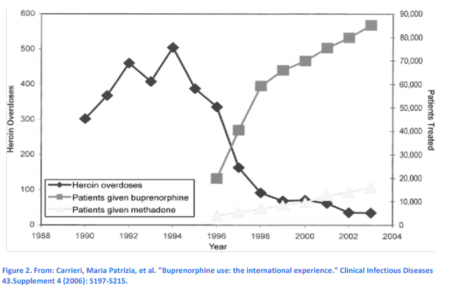
The France experience: 80% drop in deaths
5/9/2018
28

Slide 29
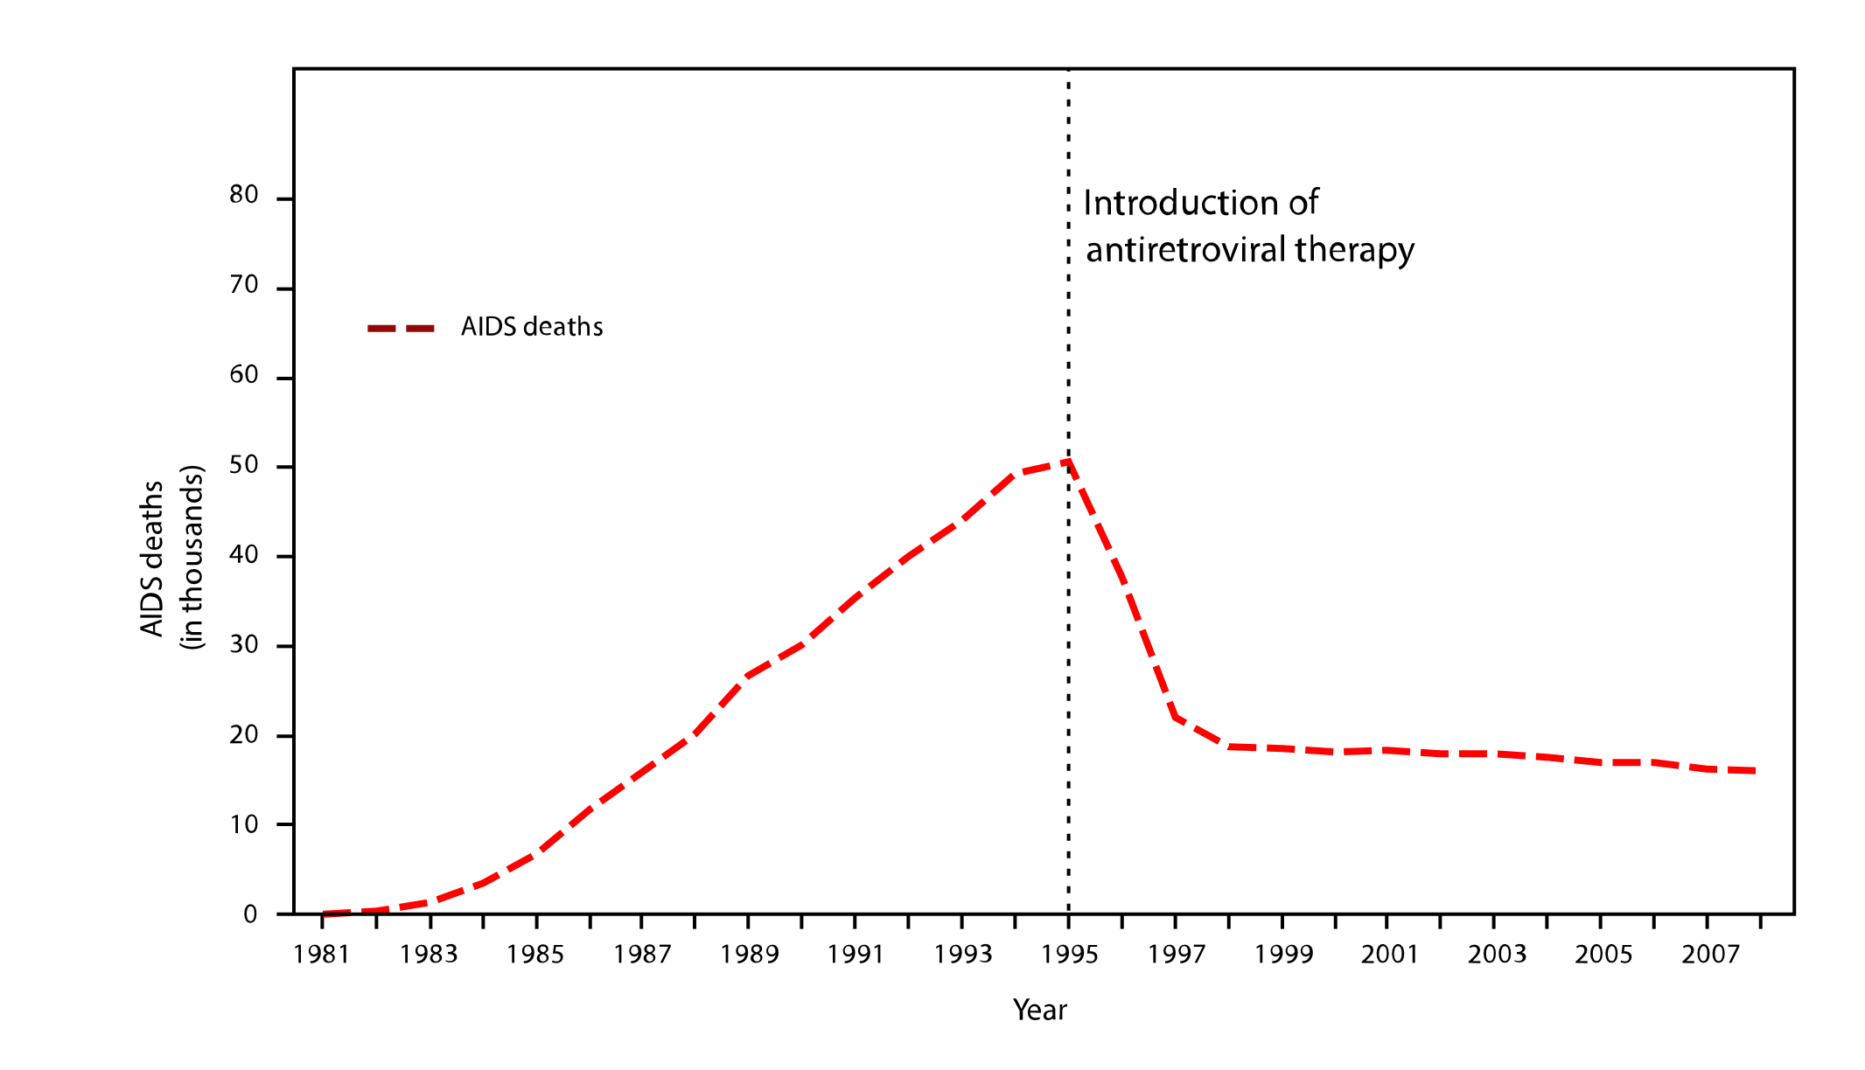
What can we learn from another epidemic?
US AIDS deaths, 1981-2007
Introduction of effective medications
Massive campaign to remove barriers to treatment
Anti-stigma campaign
--- AIDS deaths
Source: Centers for Disease Control, National Center for HIV/AIDS, Viral Hepatitis, STD, and TB Prevention
5/9/2018
29
Notes:
IT has been said this epidemic is the defining health crisis of our time.
There was another epidemic that looked like this one – death rates steadily rising, people stigmatized and blamed for their disease.
You may remember kids with AIDS were barred from schools, and misunderstanding about AIDS left many victims ostracized and alone.
But two things changed – wide availability of effective medications, and broad anti-stigma campaigns. Rock Hudson and Magic Johnson brought the general public along to see AIDS as a disease, not a moral failing.
We need to do the same with opioid addiction: make effective treatment available everywhere, and reduce stigma.
But there are multiple barriers to expanding access to MAT. When France eliminated all barriers, opioid deaths dropped 79% in 4 years – California is trying to do the same by making treatment available throughout our state – through hub and spoke models, and other efforts. But it will be hard to achieve the results they saw in France:
-- France required insurance plans to pay more for primary care docs to treat addiction – while many insurance companies still have authorization barriers preventing easy access, requiring doctors and patients to go through unnecessary hurdles.
-- France eliminated training and waiver requirements, while those are still in place in the US

Slide 30
Prescription for Today
Use local data
Frame as a public health crisis
Engage broadly
Be specific in goal setting
Communicate a lot
Lean into other coalitions and supports
A sense of humor
Bring your Superpower

Slide 31
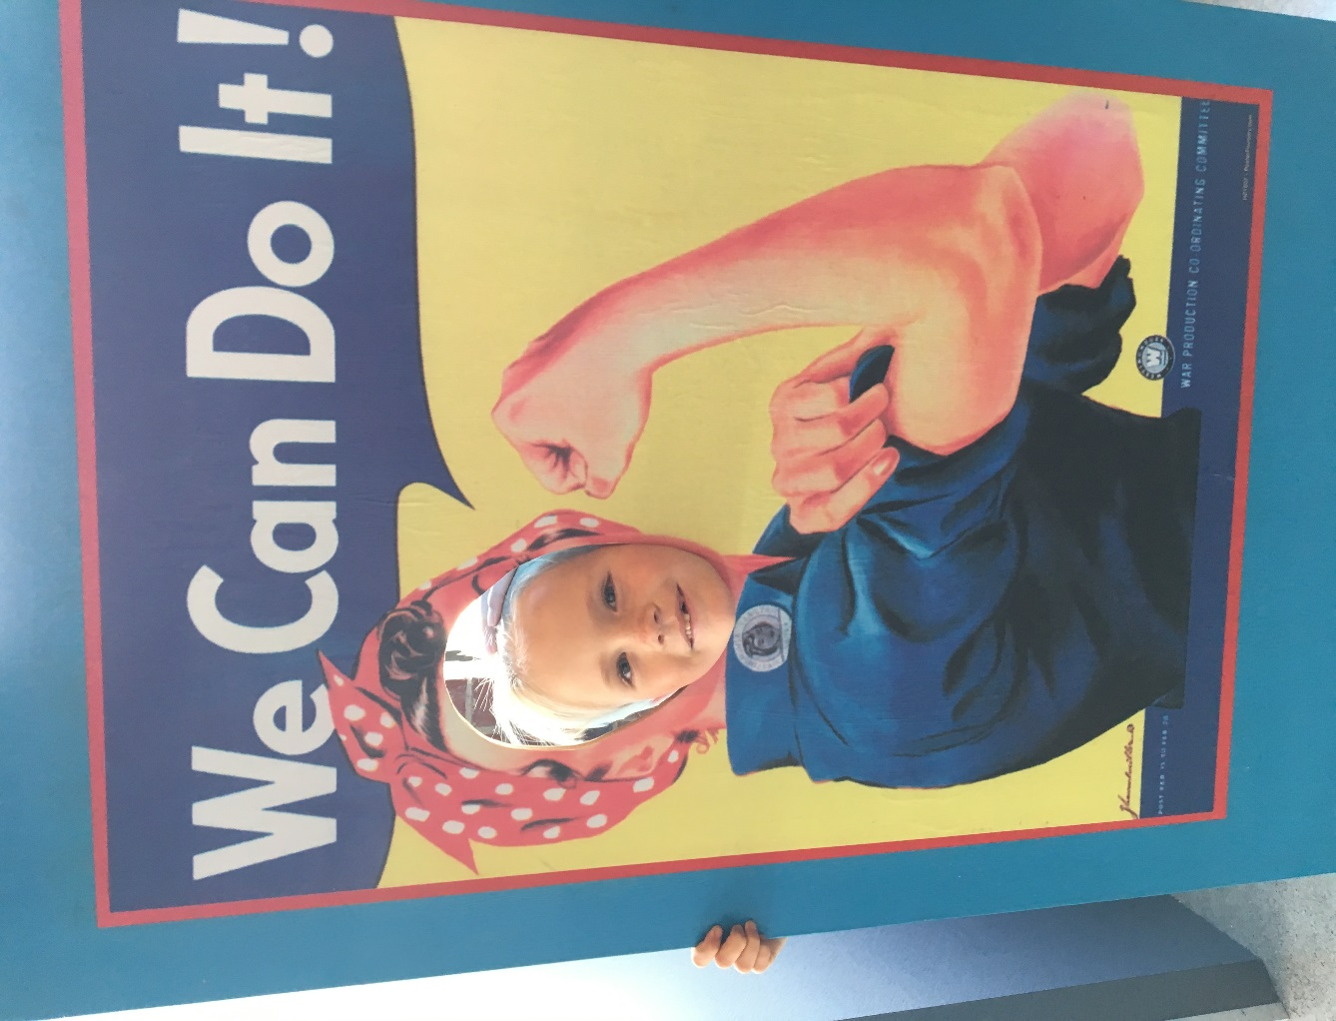
THANK YOU
Stay connected!
www.RxSafeMarin.org
Facebook.com/RxSafeMarin
RxSafeMarin@gmail.com
jdevido@marincounty.org

