Slide 1
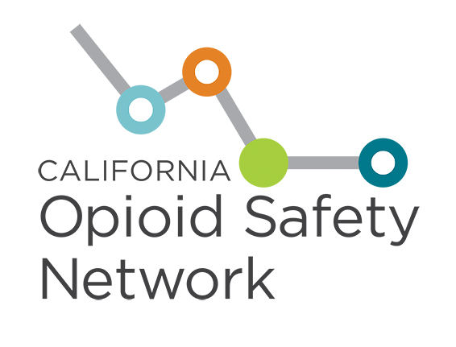
Notes:
PHI’s runs the CA Opioid Safety Network, which aims to strengthen the capacity and impact of local opioid safety coalitions across CA.
Led by CHLP – based off our experience running multi-sector leadership programs for hundreds of multi-sector teams on behalf of CDC and others.
Funded by the California Health Care Foundation, which began supporting local opioid coalitions in 2015. They recognized that culture in local, and as a result, an effective response to the opioid crisis requires systems change at the local level in which different sectors talk to each other and work together to attack this problem.
exciting partnership with the California AmeriCorps program- recruiting and training up to 40 VISTA volunteers to serve in local coalitions across the state. This is the largest opioid-focused AmeriCorps program in the country.
We’re also working in partnership with our state partners at CDPH to coordinate our respective support efforts to coalitions.

Slide 2
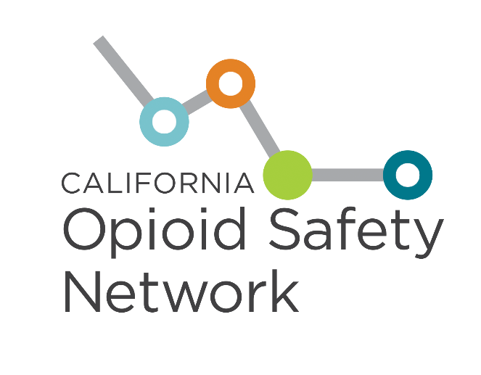
The California Opioid Safety Network is a statewide forum for all coalitions, organizations and individuals working to combat the opioid crisis in California.
The Network’s Accelerator Program provides local coalitions with customized coaching, technical assistance and networking opportunities to strengthen their impact.
Notes:
Our Network provides a statewide forum for all coalitions, organizations and individuals working to combat the opioid crisis in California. Currently 40 out of 58 counties have a coalition in our network, which covers over 90% of the California population. And the number of coalitions is growing, as we’re hearing from more and more new groups forming across the state.
Our ACCELERATOR is a specialized program that provides coalitions with customized coaching from our team of former health officers and clinicians, technical assistance from subject matter experts, and a range of in-person and virtual networking opportunity to share resources and boost their impact.

Slide 3
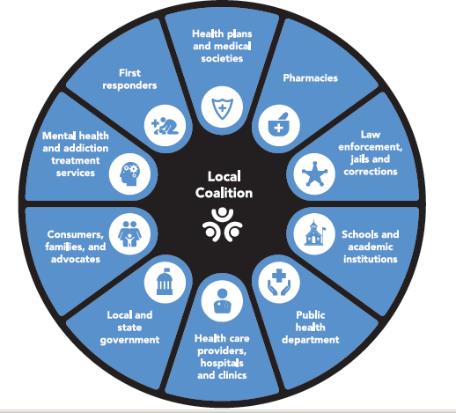
Notes:
How do we improve opioid safety at the local level? There is a groundswell of local coalitions across CA that are a driving force for community-driven responses to the opioid crisis.
Coalition intended to build a group of people from different sectors committed to solution of a problem. Bring own perspectives, knowledge, assets and resources with common vision and issue to tackle. Powerful. Whole organic entity of folks coming together figuring out what to do with very complex, pervasive problem.
Coalitions take an “all hands on deck” approach by bringing together the constellation of local partners needed to:
Prevent SUD
Manage patients on chronic opioids
Provide treatment,
Stop overdose deaths,
And build more resilient communities.
These coalitions consist of pharmacists, behavioral health specialists, law enforcement, first responders, health care providers, and others that all play a part in combating this issue.
An area we want to expand is faith-based and businesses.

Slide 4
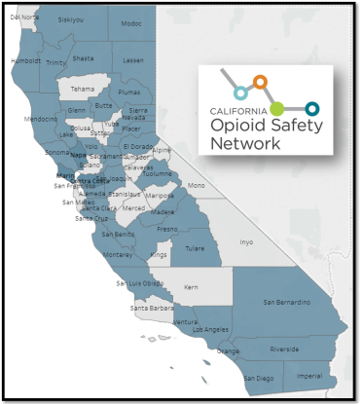
California Opioid Safety Network
40 counties with local opioid safety coalitions
Coalition leaders: medical societies, county leaders, public health, hospitals, advocates and others.
Participants: medical providers, pharmacies, law enforcement and corrections, advocates, consumers and families, addiction treatment specialists, health plans, and others.
Priorities:
Opioid over-prescribing
Access to addiction treatment
Naloxone and harm reduction
Notes:
58 counties in CA: It is very difficult to change how doctors treat pain and to overcome NIMBY concerns.
Culture is local – and we realized we needed local leaders to work on all three areas: reducing prescribing, increasing access to addiction treatment, and ensuring naloxone or Narcan is available wherever needed.
Based on models in Marin and San Diego, CHCF launched the CA Opioid Safety Network – now 40 counties, representing 90% of Californians (around 35M people), have active coalitions fighting the epidemic.
STORIES
These counties are full of inspiring stories – like a librarian who saved a life because she was trained to use Narcan. Like Plumas county - -used to be the highest death rate in the state, and had NO opioid treatment access; and then the public health department got going, the health officer learned to treat addiction, and they brought the community to solve problems together – they had no prescription overdose deaths in 2016

Slide 5
Accelerator Program:
24 coalitions covering
32 counties
Notes:
Most counties across the state have local coalitions that are part of the network.
Our Accelerator program currently serves 24 coalitions covering 32 counties.

Slide 6
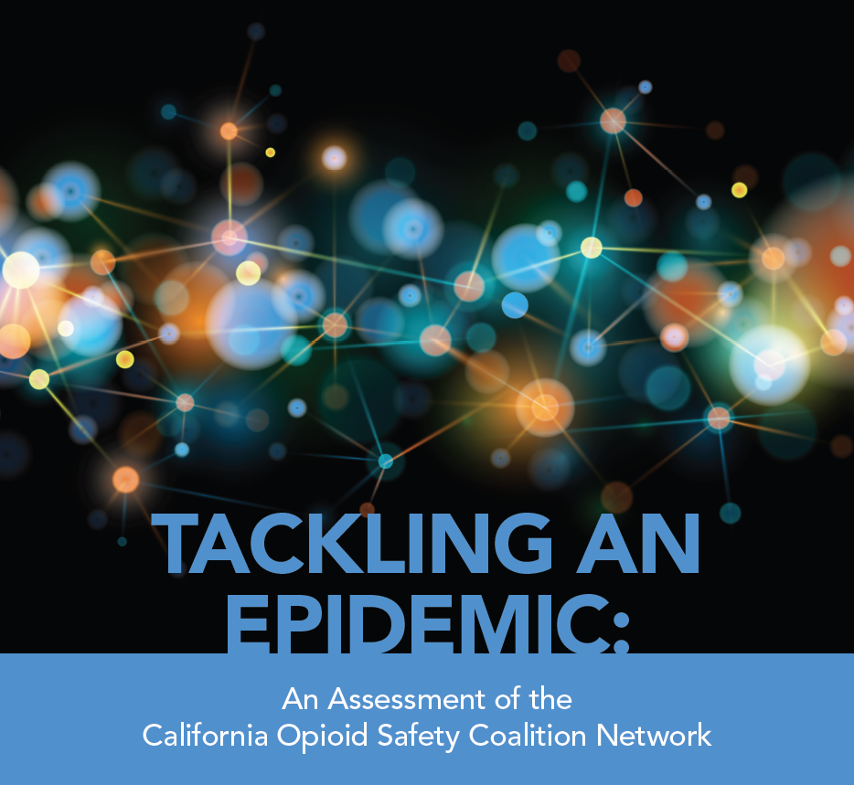
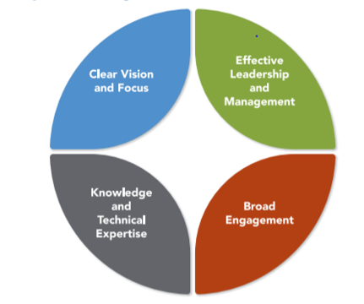
Characteristics of a “Healthy” Opioid Safety Coalition
Notes:
We designed the Accelerator program based on a report CHCF commissioned PHI to do.
Found eearly evidence of the real impact coalitions were making in improving safe prescribing, MAT delivery, and Naloxone distribution.
And we even found that counties with coalitions that received support from CHCF had lowered their overall opioid prescribing rates and higher buprenorphine prescribing that counties without CHCF-backed coalitions.
In this assessment we also looked what makes a strong and “healthy” coalition
Knowledge, EXPERIENCE, and technical expertise
Promote Collective Impact Model (Vision/Mission/Strategies; Metrics; Communication; Mutually re-enforcing actions; Support and Infrastructure)

Slide 7
Coalition Impact:
Greater reductions in opioid prescribing and increased Buprenorphine prescribing in coalition counties
Notes:
We’ve already seen that coalitions across California are making a difference.
An analysis using data from the state opioid surveillance dashboard found greater reductions in opioid prescribing in counties with a foundation-backed coalition.
The rate of decline in opioid prescriptions and the decrease in average annual opioid dose were faster in counties with foundation-backed coalitions, compared to those without such coalition support.
In addition, counties with foundation-supported coalitions had nearly double the increase in buprenorphine prescribing rates than counties without coalition support, a marker for faster increase in access to effective addiction treatment.

Slide 8
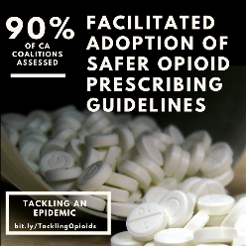
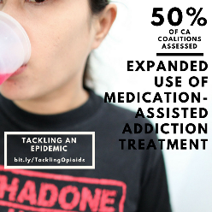
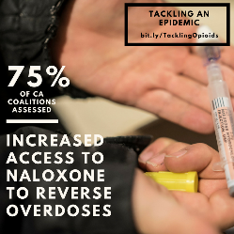
Notes:
Outcomes of original coalition cohort (n=16) supported by CHCF
Ongoing evaluation of the COSN Accelerator Program?

Slide 9
Notes:
The 5 strategies are outlined in our program model.
The overlapping circles designate the core components of our program, which is designed to fortify the impact of local coalitions through performance improvement, coaching, and subject matter expertise around strategy implementation.
And we also provide support and peer learning opportunities to strengthen coalition capacity related to data access, use and management; effective internal and external communications; and sustainability

Slide 10
Coalition Accelerator Program
Impact coaching
Peer networking and strategy sessions
Subject matter expert ‘bullpen’
Web-based learning
Website
Templates and Tools
Regional workshops and convenings
AmeriCorps VISTA assignees
Program newsletter & Network digest
Notes:
So how do we do this?
Since our launch, we’ve began supporting coaltion teams through a variety of modalities including expert coaching, web-based learning, and strategy sessions with peer coalitions.
Just today we launched a portal on our website for those in the program to download and exchange materials with other coalitions, and we are preparing our first set of convenings in July for members of the program to connect and participate in in-person workshops.

Slide 11
Strategies for Getting to
Zero Overdose Deaths in CA
Prevent
addiction and harm
Fewer new starts on long-term opioid use
Manage
chronic pain safely
Alternative pain therapies
Slowly tapering high dosages to safer dosages
Treat
addiction
Medications for addiction treatment (MAT)
Stop
overdose deaths
Naloxone
Needle exchanges
Supervised injection sites
Limiting opioids + sedatives
Reduce stigma
Opioids used for fewer diagnoses, shorter durations, and lower doses
Upstream prevention and education
Notes:
Mark

Slide 12
Prevent Strategies
--Development and distribution of pain management and opioid prescribing guidelines
--Engaging pharmacists to monitor physician and patient compliance with prescribing guidelines
--Distribution of “take-back” boxes
--Public awareness campaigns: proper pain management, disposal of unused drugs
--Academic detailing
--Communicating with prescribers whose patients have died of or been rescued from an overdose
--Focus on high prescribers: dentists, surgeons, ob-gyn, ED docs
--Promote utilization of CURES
--EMR modification to support prescribing decisions

Slide 13
Manage Strategies
--Development and distribution of opioid-tapering protocols
--Development and distribution of alternative pain management toolkits
--Training on management of difficult patients
--Teaming with behavioral health, pain management specialists, and social services when appropriate

Slide 14
Treat Strategies
--Hub and spoke treatment networks
--DMC-ODS Pilots
--Use of PAs and NPs
--Buprenorphine waver-training
--Integrating BH and SS into MAT model
--Initiating treatment in EDs, hospitals, jails
--Working with primary care providers to expand access to treatment services
--Use of telemedicine

Slide 15
Stop Strategies
--Partnering with health system hub and spoke grantees for purchase of naloxone
--Taking advantage of SHO’s standing order for distribution of naloxone
--Promoting co-prescribing buprenorphine and naloxone
--Educating school nurses and student health services on use and availability of naloxone
--Working with law enforcement and fire/rescue to ensure access to naloxone
--Developing protocols for case management and follow-up on rescues to ensure referral to treatment
--Working on stigma/misconceptions regarding use of Naloxone
--Syringe access, disposal and recovery (SF)
--Safe Injection sites

Slide 16
National service program founded in 1965
COSN manages largest VISTA program in the country: 40 placements in coalitions across CA
VISTAs enhance coalition capacity, infrastructure and sustainability

Slide 17
Use of VISTA assignees
--Survey MAT sites to map and catalogue scope of services
--Review coroner’s reports for evidence of opioid contribution to cause of death
--Create and manage website//manage external communications/social networks
--Conduct and follow up on academic detailing
--Survey Pharmacies: Requiring a prescription for naloxone?
--General support of Coalition workgroups

Slide 18
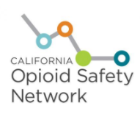
California’s Coordinated Campaigns
Local opioid safety coalitions
Addiction treatment expansion programs for Medicaid and uninsured
Collaboration of public purchasers
Statewide Opioid Safety (SOS) Workgroup
Notes:
There are several statewide efforts, all coordinated:
The California Opioid Safety Network helps local leaders fight the epidemic by supporting the efforts of local county coalitions
SMART CARE CA – our three big public health care purchasers (Medi-Cal, Covered CA and CalPERS) are working together through plans, providers and consumers
Finally, two big drug treatment efforts led by the Department of Health Care Services.
We all meet together in our Statewide Opioid Safety workgroup, led by our Public Health Officer, Dr. Karen Smith, aiming to coordinate all efforts.

Slide 19
Contact Info www.californiaopioidsafetynetwork.org

