Slide 1
Calaveras County Water District
Capital R&R Program
Funding Options
March 25, 2015

Slide 2
Funding Options
Staff was requested by Board members to calculate the financial impact on Capital R&R water and wastewater programs and revenues under following scenarios:
Option A – Proceed with September 1, 2015 rate increase
Option B – Suspension of September 1, 2015 rate increase
Option C - Suspension of September 1st rate increase plus a $5 per month rate reduction
Option D - Suspension of September 1st rate increase plus a 10% per month rate reduction
Water - $5.68 per month for 5/8” meter
Wastewater - $8.62 per month for standard residential

Slide 3
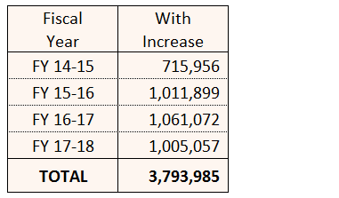
Wastewater – Option A
Proposed monthly rate - $90.00
O&M - $67.50
Capital R&R - $22.50
Revenue projections, after payment of debt service:

Slide 4
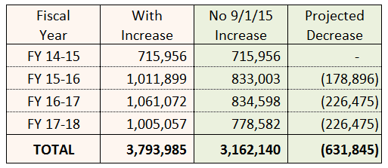
Wastewater – Option B
Current monthly rate - $86.16
O&M - $67.50
Capital R&R - $18.66
Revenue projections, after payment of debt service:

Slide 5
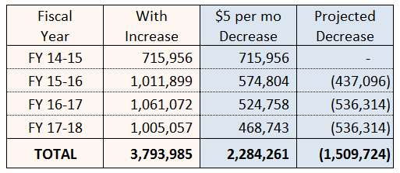
Wastewater – Option C
Monthly rate with $5 decrease - $81.16
O&M - $67.50
Capital R&R - $13.66
Revenue projections, after payment of debt service:

Slide 6
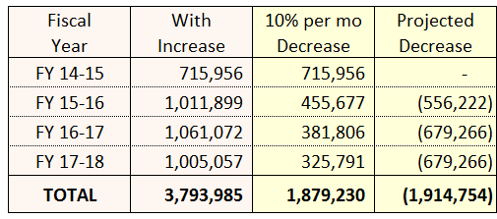
Wastewater – Option D
Monthly rate with 10% decrease ($8.62) - $77.54
O&M - $67.50
Capital R&R - $10.04
Revenue projections, after payment of debt service:

Slide 7
Capital R&R Projects - Wastewater
Copper Cove Lift Station 22 Replacement Project
Copper Cove Reclaim Plant Permit and Pump Project
Copper Cove Lift Station 8, 12 & 13 Bypass Project
Lift Station Renovations
Arnold Wastewater Treatment Plant Permit Update and Disposal Field Improvements

Slide 8
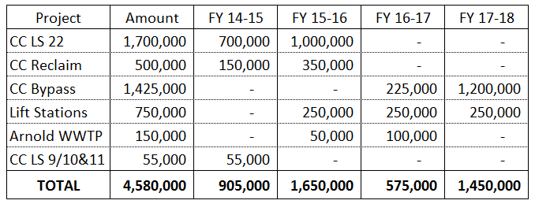
Wastewater R&R Projects
3 year Capital R&R program to Engineering Committee:

Slide 9
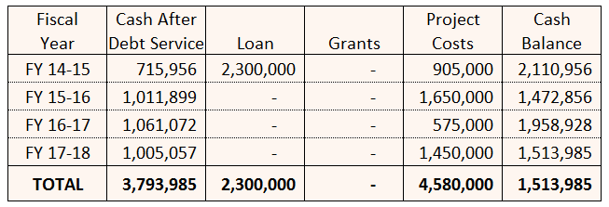
Wastewater Cash Flow – Option A
Proceed with Sept 1 increase:

Slide 10
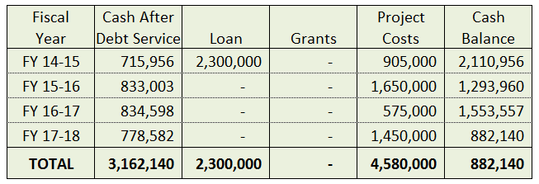
Wastewater Cash Flow – Option B
No Sept 1 increase:

Slide 11
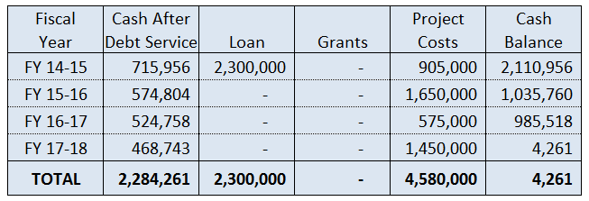
Wastewater Cash Flow – Option C
No Sept 1 increase plus $5 per month rate decrease:

Slide 12
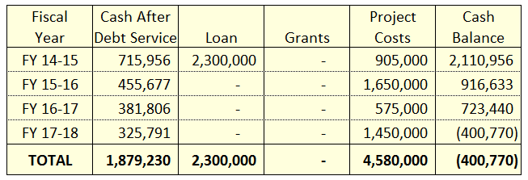
Wastewater Cash Flow – Option D
No Sept 1 increase plus 10% per month rate decrease:

Slide 13
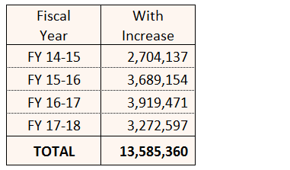
Water – Option A
Proposed monthly rate - $61.89
O&M - $39.50
Capital R&R - $22.39
Revenue projections, after payment of debt service:

Slide 14
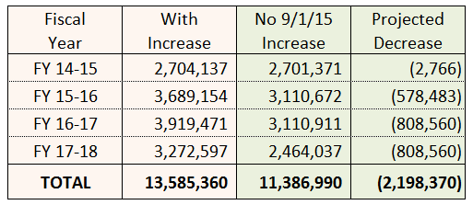
Water – Option B
Current monthly rate - $56.78
O&M - $39.50
Capital R&R - $17.28
Revenue projections, after payment of debt service:

Slide 15
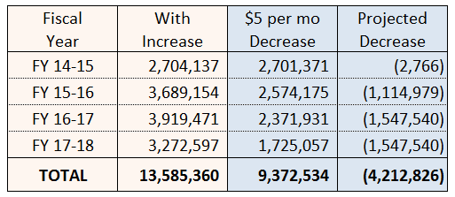
Water – Option C
Monthly rate with $5 decrease - $51.78
O&M - $39.50
Capital R&R - $12.28
Revenue projections, after payment of debt service:

Slide 16
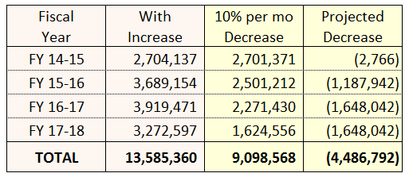
Water – Option D
Monthly rate with 10% decrease ($5.68) - $51.10
O&M - $39.50
Capital R&R - $11.60
Revenue projections, after payment of debt service:

Slide 17
Capital R&R Projects - Water
Ebbetts Pass Reach 3A Water Pipeline Replacement
Redwood Tank Replacement
Ebbetts Pass Reach 1 Water Line Replacement
Mill Pond Project
Jenny Lind A-B Transmission Line Replacement
Tank Management Plan

Slide 18
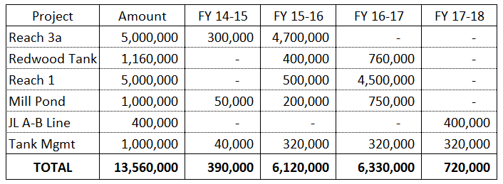
Water R&R Projects
3 year Capital R&R program to Engineering Committee:

Slide 19
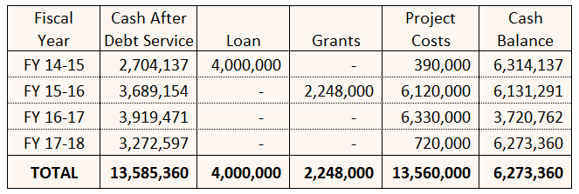
Water Cash Flow – Option A
Proceed with Sept 1 increase:

Slide 20
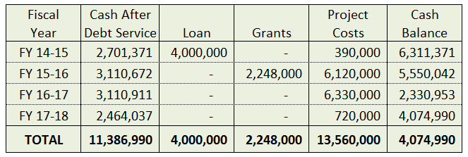
Water Cash Flow – Option B
No Sept 1 increase:

Slide 21
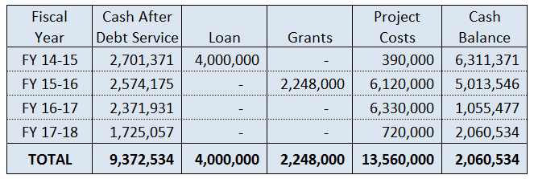
Water Cash Flow – Option C
No Sept 1 increase plus $5 per month rate decrease:

Slide 22
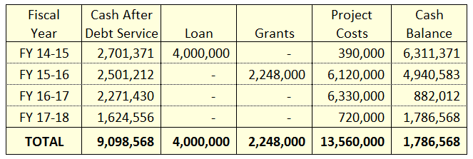
Water Cash Flow – Option D
No Sept 1 increase plus 10% per month rate decrease:

Slide 23
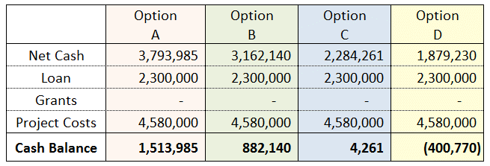
Wastewater Funding Options
Option A – Proceed with Sept 1st rate increase
Option B - Suspend Sept 1st rate increase
Option C - Suspend Sept 1st rate increase – $5/mo decrease
Option D - Suspend Sept 1st rate increase – 10%/mo decrease

Slide 24
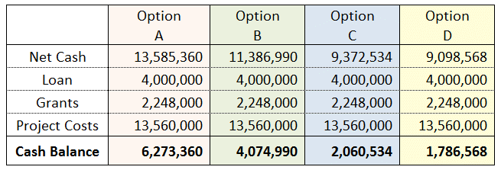
Water Funding Options
Option A – Proceed with Sept 1st rate increase
Option B - Suspend Sept 1st rate increase
Option C - Suspend Sept 1st rate increase – $5/mo decrease
Option D - Suspend Sept 1st rate increase – 10%/mo decrease

Slide 25
Recommendation
Board suspends the September 1, 2015 rate increase for water and wastewater
Staff will prepare the FY 2015-16 Budget to reflect the suspension of the rate increase
District will notify customers of the suspension of rates thru public outreach and customer service

